Slide 1


[Data Presentation]
Notes:
This Presentation covers the analysis of content categories that highlights the top 5 categories with largest aggregate popularity which was done with respect to the given score by Content Category.

Slide 2


Today's agenda
Project recap
Problem
The Analytics team
Process
Insights
Summary
Notes:
The Datasets are 3 different worksheets which are named Content, Reaction and Reaction Type.
The Content datasheet Consists of five (5) different columns named content id, User id, Type, Category anf the Url.
The Reaction Type Datasheet Consists of three (3) Columns which are Sentiment, Score and Type
The last worksheet consists of 6 columns which are Content id, Category, Type, Sentiment, Score and Datetime. This Worksheet acts as a bridge connecting the two other worksheet because it shows the relationship between the two other worksheet which is a good and healthy for our analysis.

Slide 3


Project Recap
Notes:
How have we achieved this?
My team and I spent more time on Data cleaning in other to determine accurately the analysis of content categories that highlight top 5 categories with largest aggregate population.

Slide 4



Problem
Notes:
DATA CLEANING
The first worksheet we cleaned was the reaction worksheet that consist of 6 different Columns before moving on to The other worksheets
Checking Duplicate data
Duplicate data were easily checked by highlighting all columns which consist of about 25000 rows fortunately no duplicate values was found all the worksheet. The reason for checking the duplicate value is that “to get the top 5 content categories with largest aggregate popularities” it shows typically we will be making use of the score provided for each content Sentiment and content type
Removing of irrelevant column
Columns like Url, user id were found to be irrelevant to the outcome of the analysis of this Data analytics and they removed totally.
Removing irrelevant rows
All Rows that consist of empty cells which are important to our analysis were removed using some commands in excel
Merging of the worksheet
The worksheet was merged together using the Vlookup command in excel.

Slide 5



The Analytics team
Notes:
The Analytics Team Lead by :
The Chief Teaching Architect-Andrew Fleming
Senior Principal- Marcus Rompton
Data Scientist-Michelle Grove
Data Analyst-Yakub Fatai Olayinka

Slide 6

Process
1
2
3
4
5
Notes:
ANALYSIS OF TOP CATEGORIES
After combining the dataset using the Vlookup Functions in excel the score column was then used to calculate the categories with highest popularities using the SUMIF function in excel after getting each score of each category, the scores were then arranged in ascending order to show clearly the lowest an largest dataset popularity.

Slide 7


Insights
Notes:
Category Total score of each category
Animals 74965
Science 71168
Healthy eating 69339
Technology 68738
Food 66676

Slide 8
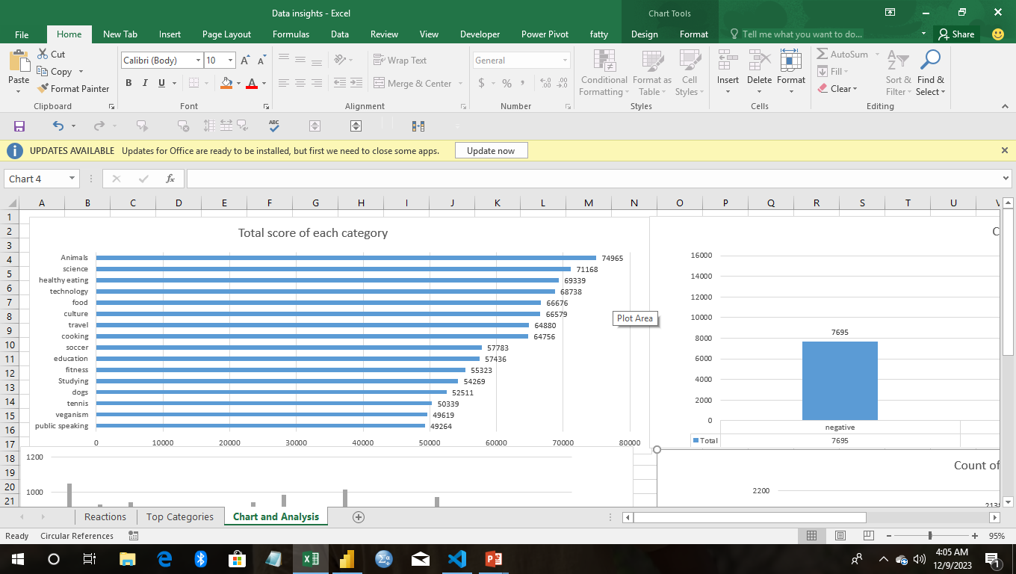

Slide 9
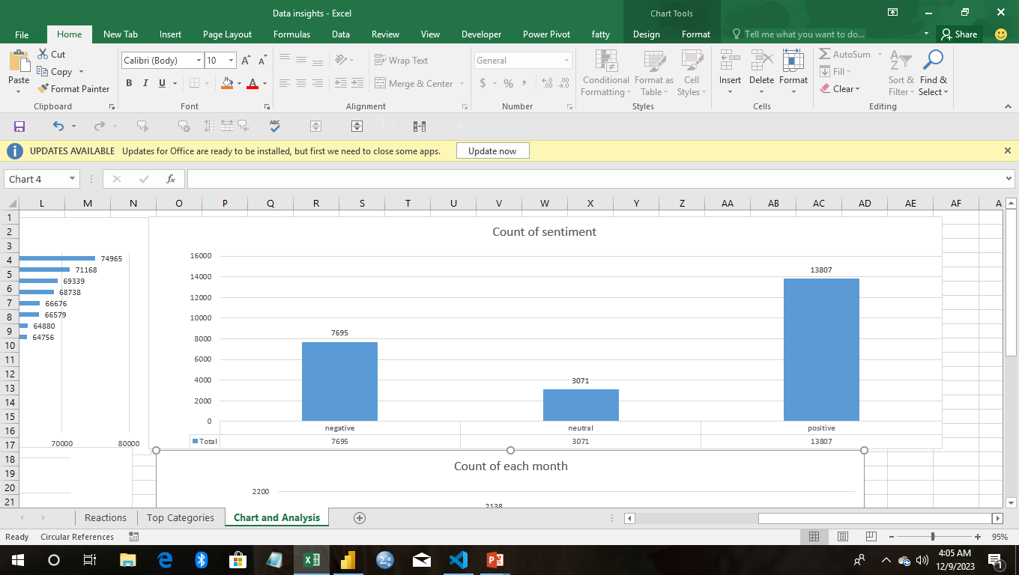

Slide 10
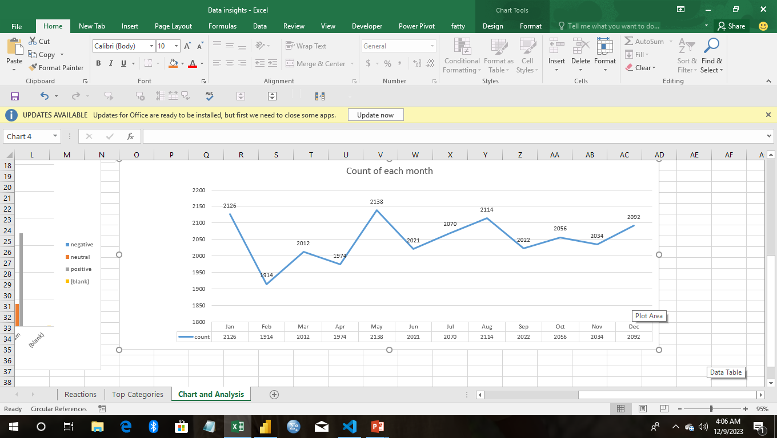

Slide 11


Summary
Notes:
IN SUMMARY
Animal has the highest popularity by given Total score of 74965 science 71168 healthy eating 69339 technology 68738 while the least of the Top 5 is Food which is 66676 by Total score

Slide 12

Thank you!
ANY QUESTIONS?
Notes:
Question should be sent directly to this mail: yakubabdulfatai123@gmail.com

